Slide 1
Programming in Visual Basic 2010:
The Very Beginner’s Guide
Chapter 14.1
LINQ to SQL
Databases – Part 1
by Jim McKeown

Slide 2
You will learn how to…
Describe a Relational Database Structure
Describe LINQ to SQL and how it's used
Create and populate a DataGridView
Write simple SQL commands
Use the QueryBuilder to create database queries

Slide 3
LINQ to SQL
The world runs on databases
Businesses depend on them for nearly all of their business needs
LINQ to SQL is the link between a Visual Basic program and a database
Significant programming and database instruction needed to become proficient at it
General principles introduced here

Slide 4
Background
Databases are usually Relational databases (RDBMS)
Part of a database management system (DBMS) that includes servers, software and data
Data usually organized in a series of tables
Relational database:
a database with multiple tables and relationships between tables
Database management system:
a database and the software to manage it

Slide 5
Background
Tables tied together by key fields
Key fields share a common name and have the same data
Microsoft Access databases are similar to DBMS but easier to use and widely available for a PC
Key fields
a field shared by two or more tables in a database; key fields are the link between tables in a relational database
like, ssan in one table; ssan in a second table.

Slide 6
Background
Database managers handle the data and equipment; ensure data is available for business processes.
Database manager:
a person who manages and maintains databases; not as cool as a programmer, but almost

Slide 7
Background
In VB, Data Manipulation handled by Language-Integrated Query (LINQ) and Structured Query Language (SQL); called LINQ to SQL
SQL is the language of most databases
Language-Integrated Query (LINQ) -
programming implementation that allows SQL statements to be integrated into a VB program
Structured Query Language (SQL)
  a database development language that allows for the searching, filtering, organizing and reports of records from a database
So, the database stores the data and your VB program provides the interface to see the data.
LINQ to SQL: the way to get data from database to screen.

Slide 8
Background
Requests for data called a Query
LINQ to SQL:
  the implementation of SQL statements into a program using the tools available in .NET;
  a seamless way to connect to a database
Query
  Search into a database;
  Queries
    Return specified fields from selected records, and
    Display them in a specific order

Slide 9
Background
Queries determine
  what tables to use
  what records are requested
  what fields in the record to retrieve
  the conditions used to search through the data
Whole books available on SQL
SQL handles the database side
LINQ manages the connection and the Visual Basic side

Slide 10
Connecting to a Database Tutorial
In general a developer “Selects” a database and determines where to display the data
This tutorial uses a Microsoft Access database
Places data in what we call a DataGridView
Wizard manages most of the decisions and does most of the work

Slide 11
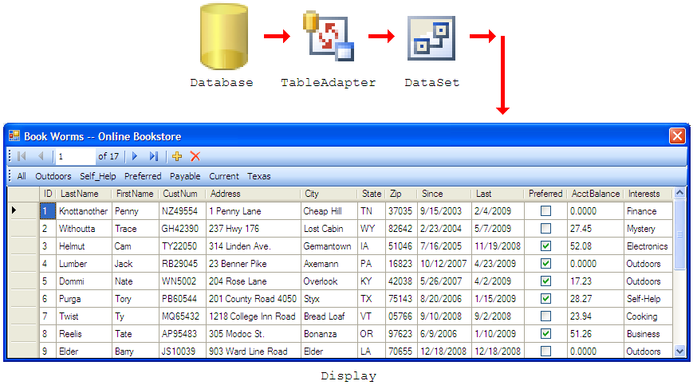
Connecting to a Database Tutorial
Connecting to a Database
Converting to the Database Grid is done for us.

Slide 12
Connecting to a Database Tutorial
Use NEC.mdb database for the tutorial
Copy it to your computer and put it in a place that’s easy to find
  Desktop is fine.
  Open and inspect it but close it before starting the tutorial
  I have placed the NEC.mdb on my webpage for you to download.
  Open it, look at it, but close it.
  I assume you have Microsoft Access w/Office
  Click icon on your desktop and select NEC is left frame.

Slide 13
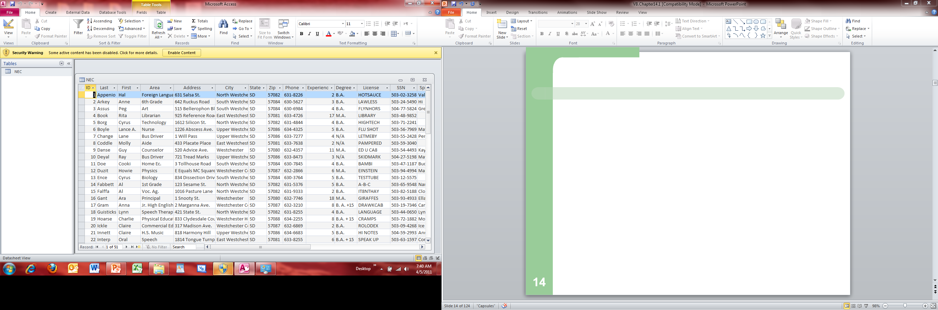

Slide 14
VB Tip
When an Access file is in use, it creates another file, for NEC it's NEC.ldb.
This file locks the database so others cannot change it.
Just don't try to have a database open in more than one application at a time.

Slide 15
Connecting to a Database Tutorial
1. Create a VB solution and name it DatabaseTutorial
  Resize the form to 800, 600
Add a DataGridView control (from ToolBox) and
Name it dgvNEC
  DataGridView displays database records
  Database displays teachers’ database for NorthEast Central High
  DataGridView: a control used to display data from DataSet
2. Name form: frmDatabaseTutorial
Save your solution
  Don’t wait because you won’t be able to establish a connection to
  the database if your solution hasn’t been saved

Slide 16
Connecting to a Database Tutorial
3. Select DataSource property of dgvNEC control
  so that you can add a DataSource to the DataGridView
  Selecting the DataSource property allows the developer to select a specific database file
  DataSource property says None but has a down-arrow in the property box.
  gives the following small window:

Slide 17
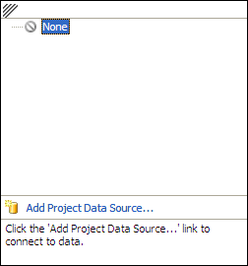
Connecting to a Database Tutorial
4. Add a Data Source
Click on link to
Add Project Data Source...
This will start a wizard that guides us (the developer) through the steps to connect to a database
The notion of “connecting” top a database is a critical concept / term in the database world.

Slide 18
Connecting to a Database Tutorial
Next two slides together: Select a Data Source Type
DataSource Configuration Wizard asks for data source type
Clearly we want a database to connect to.
5. Select Database icon and Click Next to connect to a database
  Symbol for a database is a canister
  Creates a DataSet to hold database records in memory for quick and easy access
  Canister a symbol that represents a database; it looks something like a soup can

Slide 19
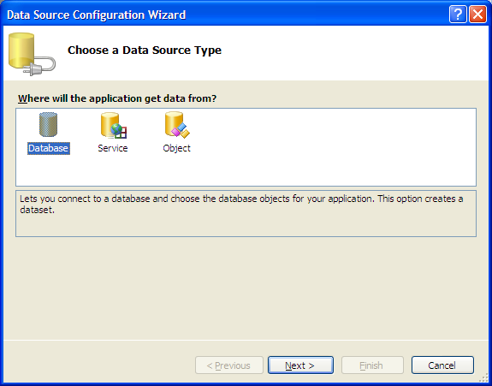
Connecting to a Database Tutorial
Data Source Configuration Wizard
Select Database;
Click Next button

Slide 20
Connecting to a Database Tutorial
Next Window: (not shown in book)
Select Database Model
6. Choose a Database Model
Select Dataset cannister, and Next

Slide 21
Connecting to the Database Tutorial
Next two slides together
Connect to a Database
Click on New Connection... Button
  (see next slide)
DataSet:
A place in memory that holds database records for quick and easy access in a program;
A DataSet stores changes, additions and deletions until they are sent back to update the database

Slide 22
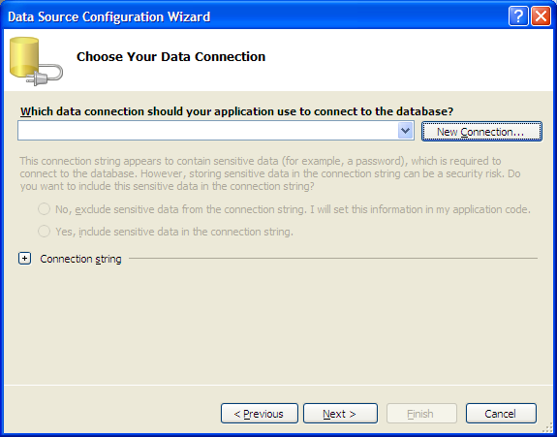
Connecting to a Database Tutorial
Data Source Configuration Wizard
Click on
New Connection

Slide 23
Connecting to a Database Tutorial
Next two slides together.
Select source of your database
Select Microsoft Access (have other choices…)
When the Add Connection dialog appears,
8. Select Change...
Change Data Source to Microsoft Access Database File
Click OK
Establishes Microsoft Access as the type of database used in this program
(This happens to be step 7 on page 574 in your book.)

Slide 24
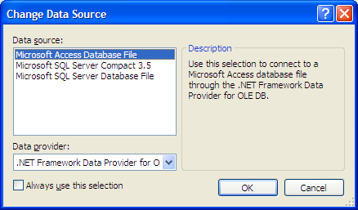
Connecting to a Database Tutorial
Look up OLE DB!!

Slide 25
Connecting to a Database Tutorial
Next two slides together
9. Select Browse...locate the NEC.mdb file on desktop
Click on desktop icon to select it
Click on the Open button to add file and path to the
Database file name:
Click on Test Connection to check the connection
Click OK (completed Step 8 in book)
Add Connection dialog set us up to work with Access files
You get dialog box: Test Connection Succeeded.
User name and Password settings aren’t a concern

Slide 26
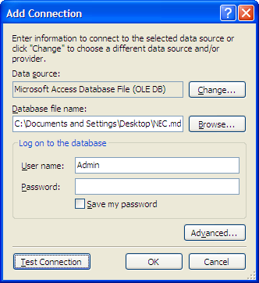
Connecting to a Database Tutorial
Add Connection Dialog

Slide 27
Connecting to a Database Tutorial
Next two slides together
10. Click Yes in the dialog box
Asks if you want to copy this file into your project folder
Happens every time local files are used
Files are then automatically copied every time the application runs

Slide 28
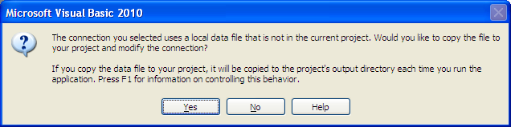
Connecting to a Database Tutorial
Local Connection Warning Dialog

Slide 29
Connecting to a Database Tutorial
Next two slides together
11. Click Next to save the Connection String

Slide 30
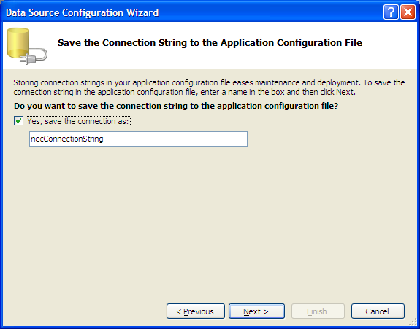
Connecting to a Database Tutorial
Save Connection String Dialog

Slide 31
Connecting to a Database Tutorial
Next two slides together
12. Select the Database Objects for the DataSet
Last step (Step 11 in your book)
Determines tables and fields available when your
program runs
Expand the Tables CheckBox
Select NEC (Selects the NEC table)
(We only have one table at this time. ☺ )
Expand the NEC table to see the fields (attributes)
(Fields are already selected; Leave selected)
Click Finish
Now have connection between pgm and database!

Slide 32
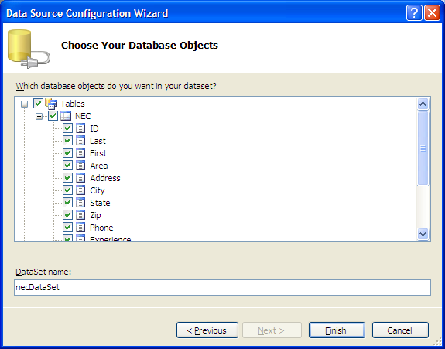
Connecting to a Database Tutorial
Choose Your Database Objects Screen
See
expansions

Slide 33
Connecting to a Database Tutorial
Summary:
DataGrid view adds and displays field names
NEC.mdb files added to Solution Explorer
Controls added to the component tray
Run your application to see the data from the NEC database

Slide 34
VB Tip
The connection between your program and a database is temporary.
It lasts only long enough to transfer the data to and from the DataSet.
In that sense, it's very similar to file I/O.

